Slide 1

Coffee Sales Analysis
Using Power Bi
Stacey Dorrian
November 2024

Slide 2
Project Brief
The data was provided by Maven analytics, for a fictious coffee chain based in New York USA
The data includes sales, inventory, employee and inventory information.
I played the role of a business intelligence analyst hired to review the data and prepare a report of insights to aid future strategy.
The project is designed to showcase analyst skills to interpret data and create a visual dashboard using Power Bi.

Slide 3
Data Set Overview
A collection of raw csv files were provided including:
Calendar – dim table – 2017 to 2019
Customer Look Up – dim table – 2,250 distinct customers
Employee Look Up – dim table – 55 distinct employees
Product Look Up – dim table – 87 distinct products
Sales by Store – fact table – +900k rows
Store Look Up – dim table – 3 store lacations and 1 head office location

Slide 4
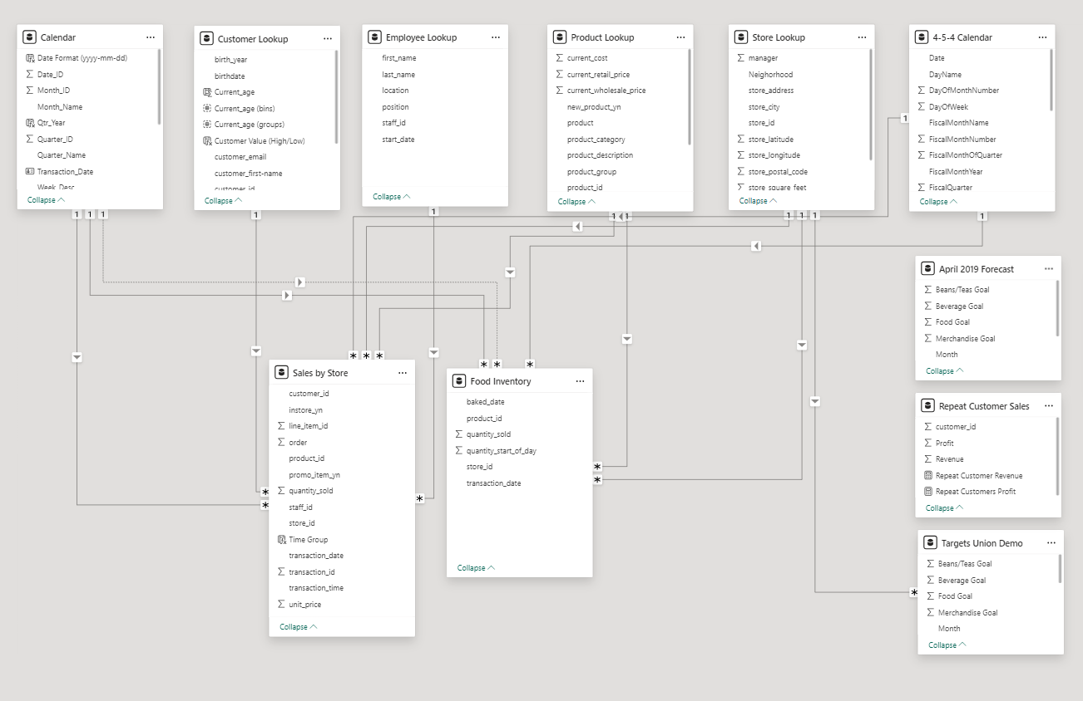
The Process
Extract Transform and Load (ETL)
The first step was to load the data into the power query editor and join the tables to create relationships.
I identified the Primary Keys and Foreign Keys to create my joins as illustrated in my image here.
I used One to Many relationships to join the dim tables to the fact tables.
Data Structure and Cleaning
The data set was quite clean (due to it being a fictious sample)
I reviewed the data types to make sure that each field would be prepped and ready for the analysis.

Slide 5
Data Transformation
Much of this project involved creating measures using DAX.
I first tackled the measures that would be used for the topline KPI page, that could then be filtered/drilled into for further insight.
Key Measures included aggregations of:
Sales (Revenue) = qty sold * unit price
Qty Sold
Profit = revenue – cost of goods sold (COGs)
Aggregations included:
Sum & Sumx
Count & Countx
Averages
YTD

Slide 6
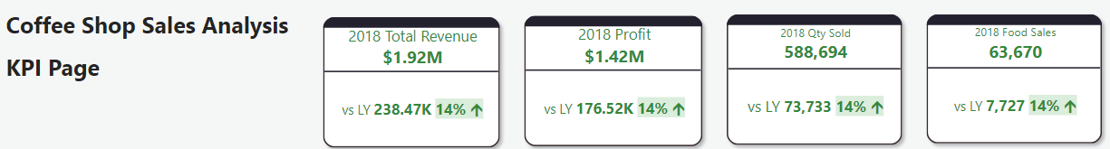
Exploratory Data Analysis (EDA)
I started by creating topline KPI’s to give me quick insight into the scale and distribution of:
Revenue
Profit
Qty (sales)
Due to 2019 data being partial, I decided to make my KPI cards as a comparison of 2018 vs 2017

Slide 7
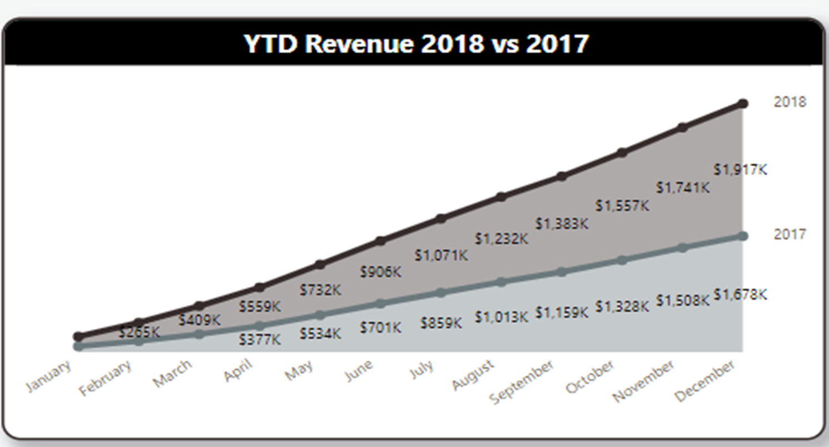
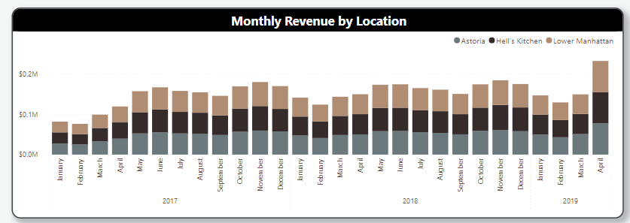
Insight and Findings
Once I had my key measures set data, I was able to establish that the business is in fairly good shape.
Sales have been increasing steadily month on month and year on year
Average (mean) revenue, qty sold and profit was in line (due to fictitious nature of the data), I would expect a real-world situation to have much messier data, and I would catch more anomalies at this stage.

Slide 8
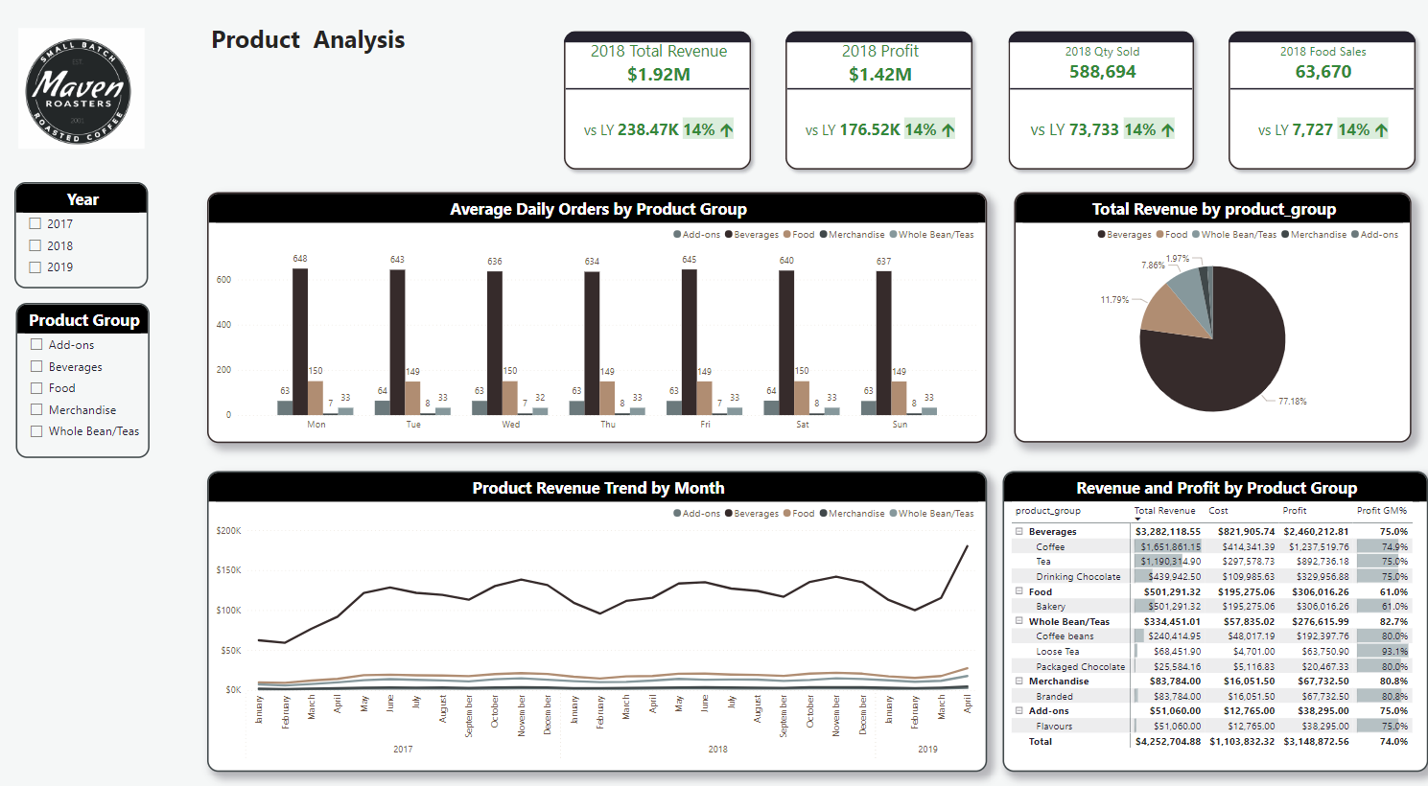
Insight and Findings -Product Analysis
The products sold by the chain fall into 5 product groups:
Beverages
Food
Whole Beans & Teas
Merchandise
Add Ons
Unsurprisingly beverages sales dominate and contributed nearly 80% of all sales.
The company also bakes and sells pastries, however there is concern that demand is not matching supply, so the business should look into strategies to sell more:
Advertising - Marketing
Give Aways – at off-peak times

Slide 9
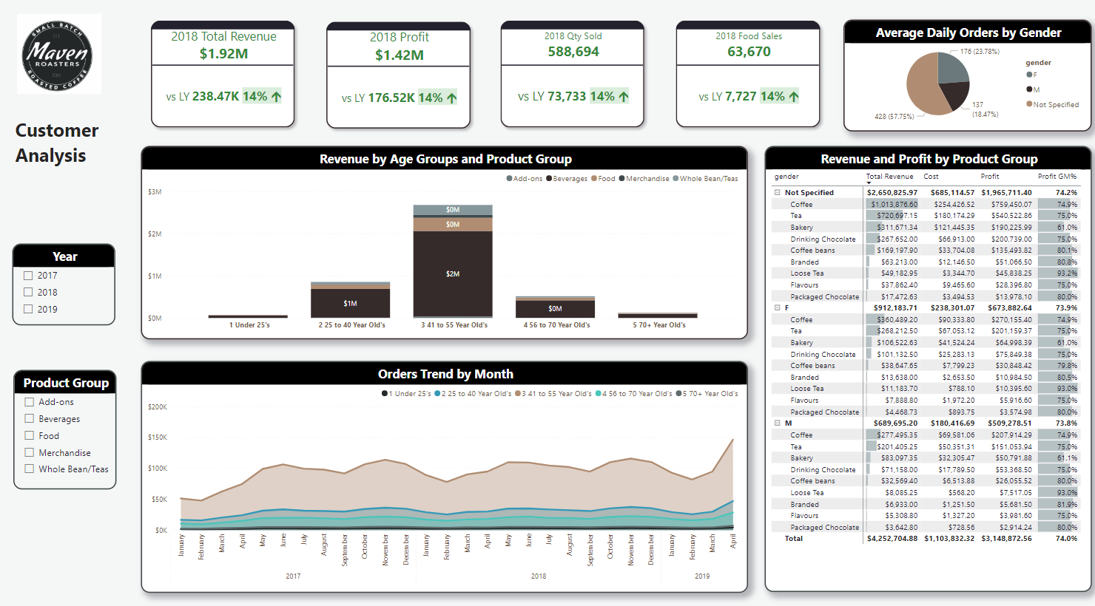
Insight and Findings -Customer Analysis
The customer database consisted of 2,250 distinct customers, there was also information on:
Age
Gender
Loyalty membership
1st transaction
I used some data modelling techniques to create age groupings to be able to gain clarity around customer behaviour.
The majority of the customers are aged between 41 and 55% and they contribute almost 50% of sales.
The next group is the 25 to 40 year olds and they contribute 16% of sales
In the next marketing meeting I would suggest that we look at ways that we can attract more customers from a wider age range
Some research may need to be done around the customers affiliation with the chain
We should also review the products and incentives offered by competitors to make sure we are optimising the customer experience.

